Slide 1

1. Identify a problem
Notes:
Teacher notes
This session explores how engineering, science and technology have made an impact on people’s lives.
It asks students to focus on areas that interest them, and finds opportunities within these areas for creative thinking.
By the end of the session, students should have found the problem they wish to solve.
This is the first of six sessions that work through the problem-solving process. They have been designed to form a basis for a one-hour session, but they can be used flexibly and adapted to suit the needs of your class. The seventh lesson provides further information on entering Google Science Fair.

Slide 2

2
3
4
5
6
7
Identify a problem
Generate ideas
Develop a solution
Design the test
Communicate the results
Draw conclusions
Enter the competition

Slide 3
Session 1: Outline
Introduce the competition Cool solves Activity 1: Idea generation diamond Activity 2: Research summary Case study Activity 2: Research summary (continued) Feasible solution Formulate your key question
5 min 10 min 10 min 10 min 5 min 10 min 5 min 5 min
05 07 12 13 14 15 16

Slide 4
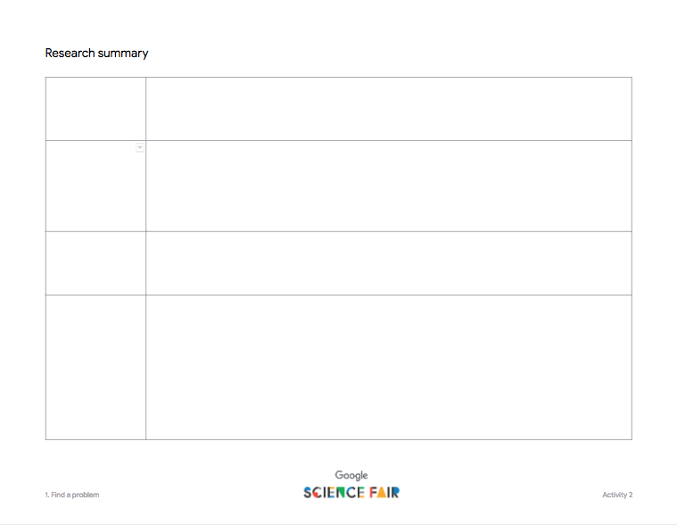
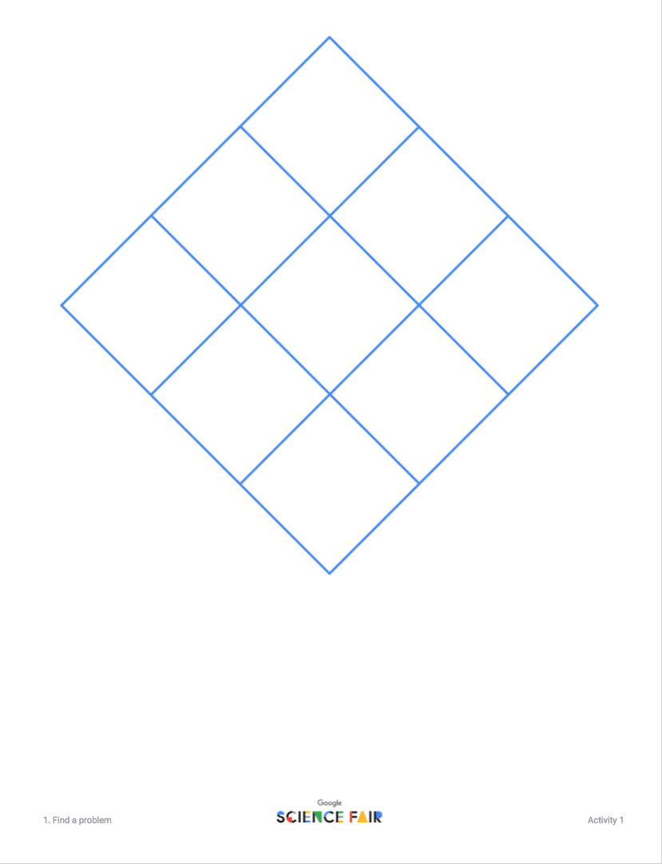
Materials you’ll need
Computer Scissors Writing supplies Activity 1: Idea generation diamond Activity 2: Research summary

Slide 5
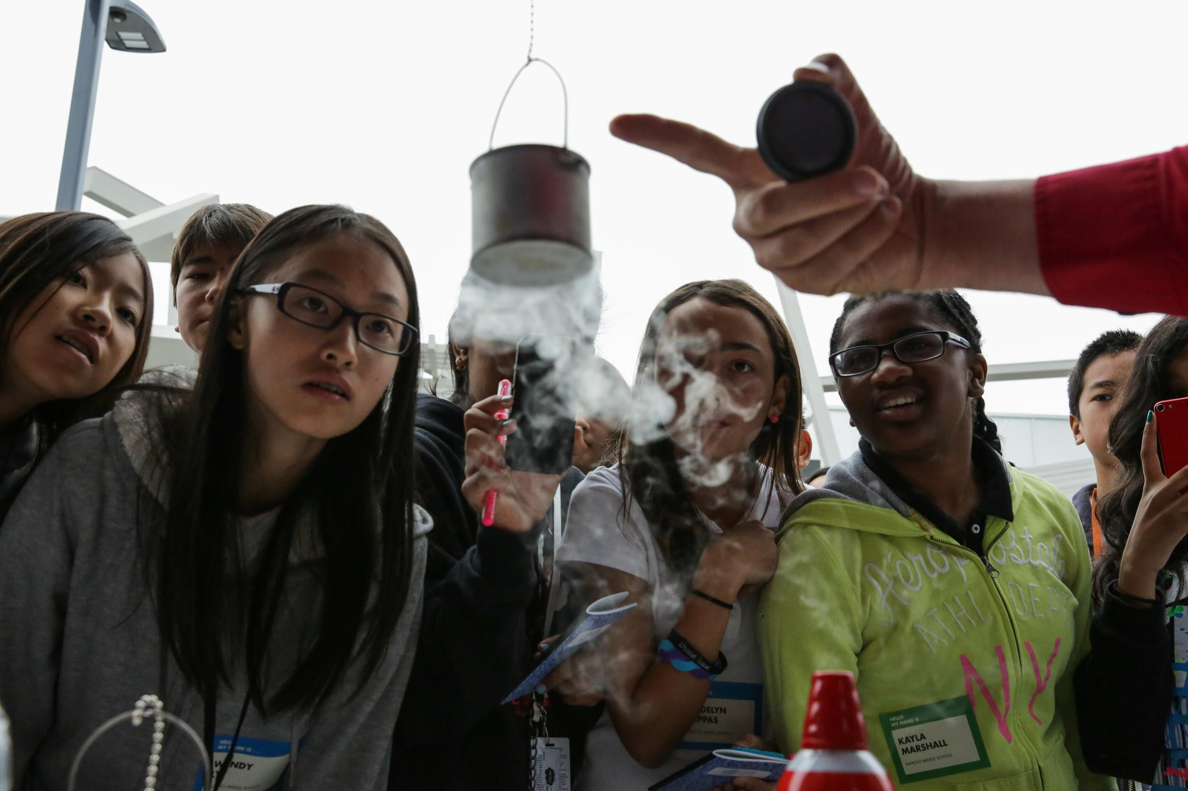

Google Science Fair is problem solving
Find a problem you care about
Think of a solution
Test it
Tell us about it!
Notes:
Teacher notes
Introduce the competition
Google Science Fair enables students to showcase their innovative and creative problem-solving projects on a global platform.
It enables 13 to 18 year-olds to have a platform for their ideas and take them further.
It also reinforces key skills that they already use every day - creativity, communication, problem solving, scientific thinking - and they can get rewarded for it with fantastic prizes.
Open to all, globally, the competition has been running since 2011 and winners have come from over 100 countries. Students will explore some of the previous finalists in these sessions, or they can find them on www.googlesciencefair.com
It’s all about finding a problem to solve, thinking about how you might solve it, then presenting your solution.
Students can enter by themselves or in groups of up to three - you could choose to group students for the sessions at the beginning, or once they have thought of ideas, if similarities arise.

Slide 6

Everything starts
with a

Slide 7
Everything starts with a question.
How can we provide light for children to study when they have no access to electricity?
Material is easily torn. How can we make pants more durable?
What happens when the batteries run out and there’s no access to new ones?
Is there a way to make cataract treatment less painful and more precise?
Is there a way to make the internet more intelligent and better suited to our needs?
Notes:
Teacher notes
Introduce these problems to students.
Tell them they have all been solved.
Ask students to think about how they may have been solved - encourage them to be creative with their ideas.

Slide 8
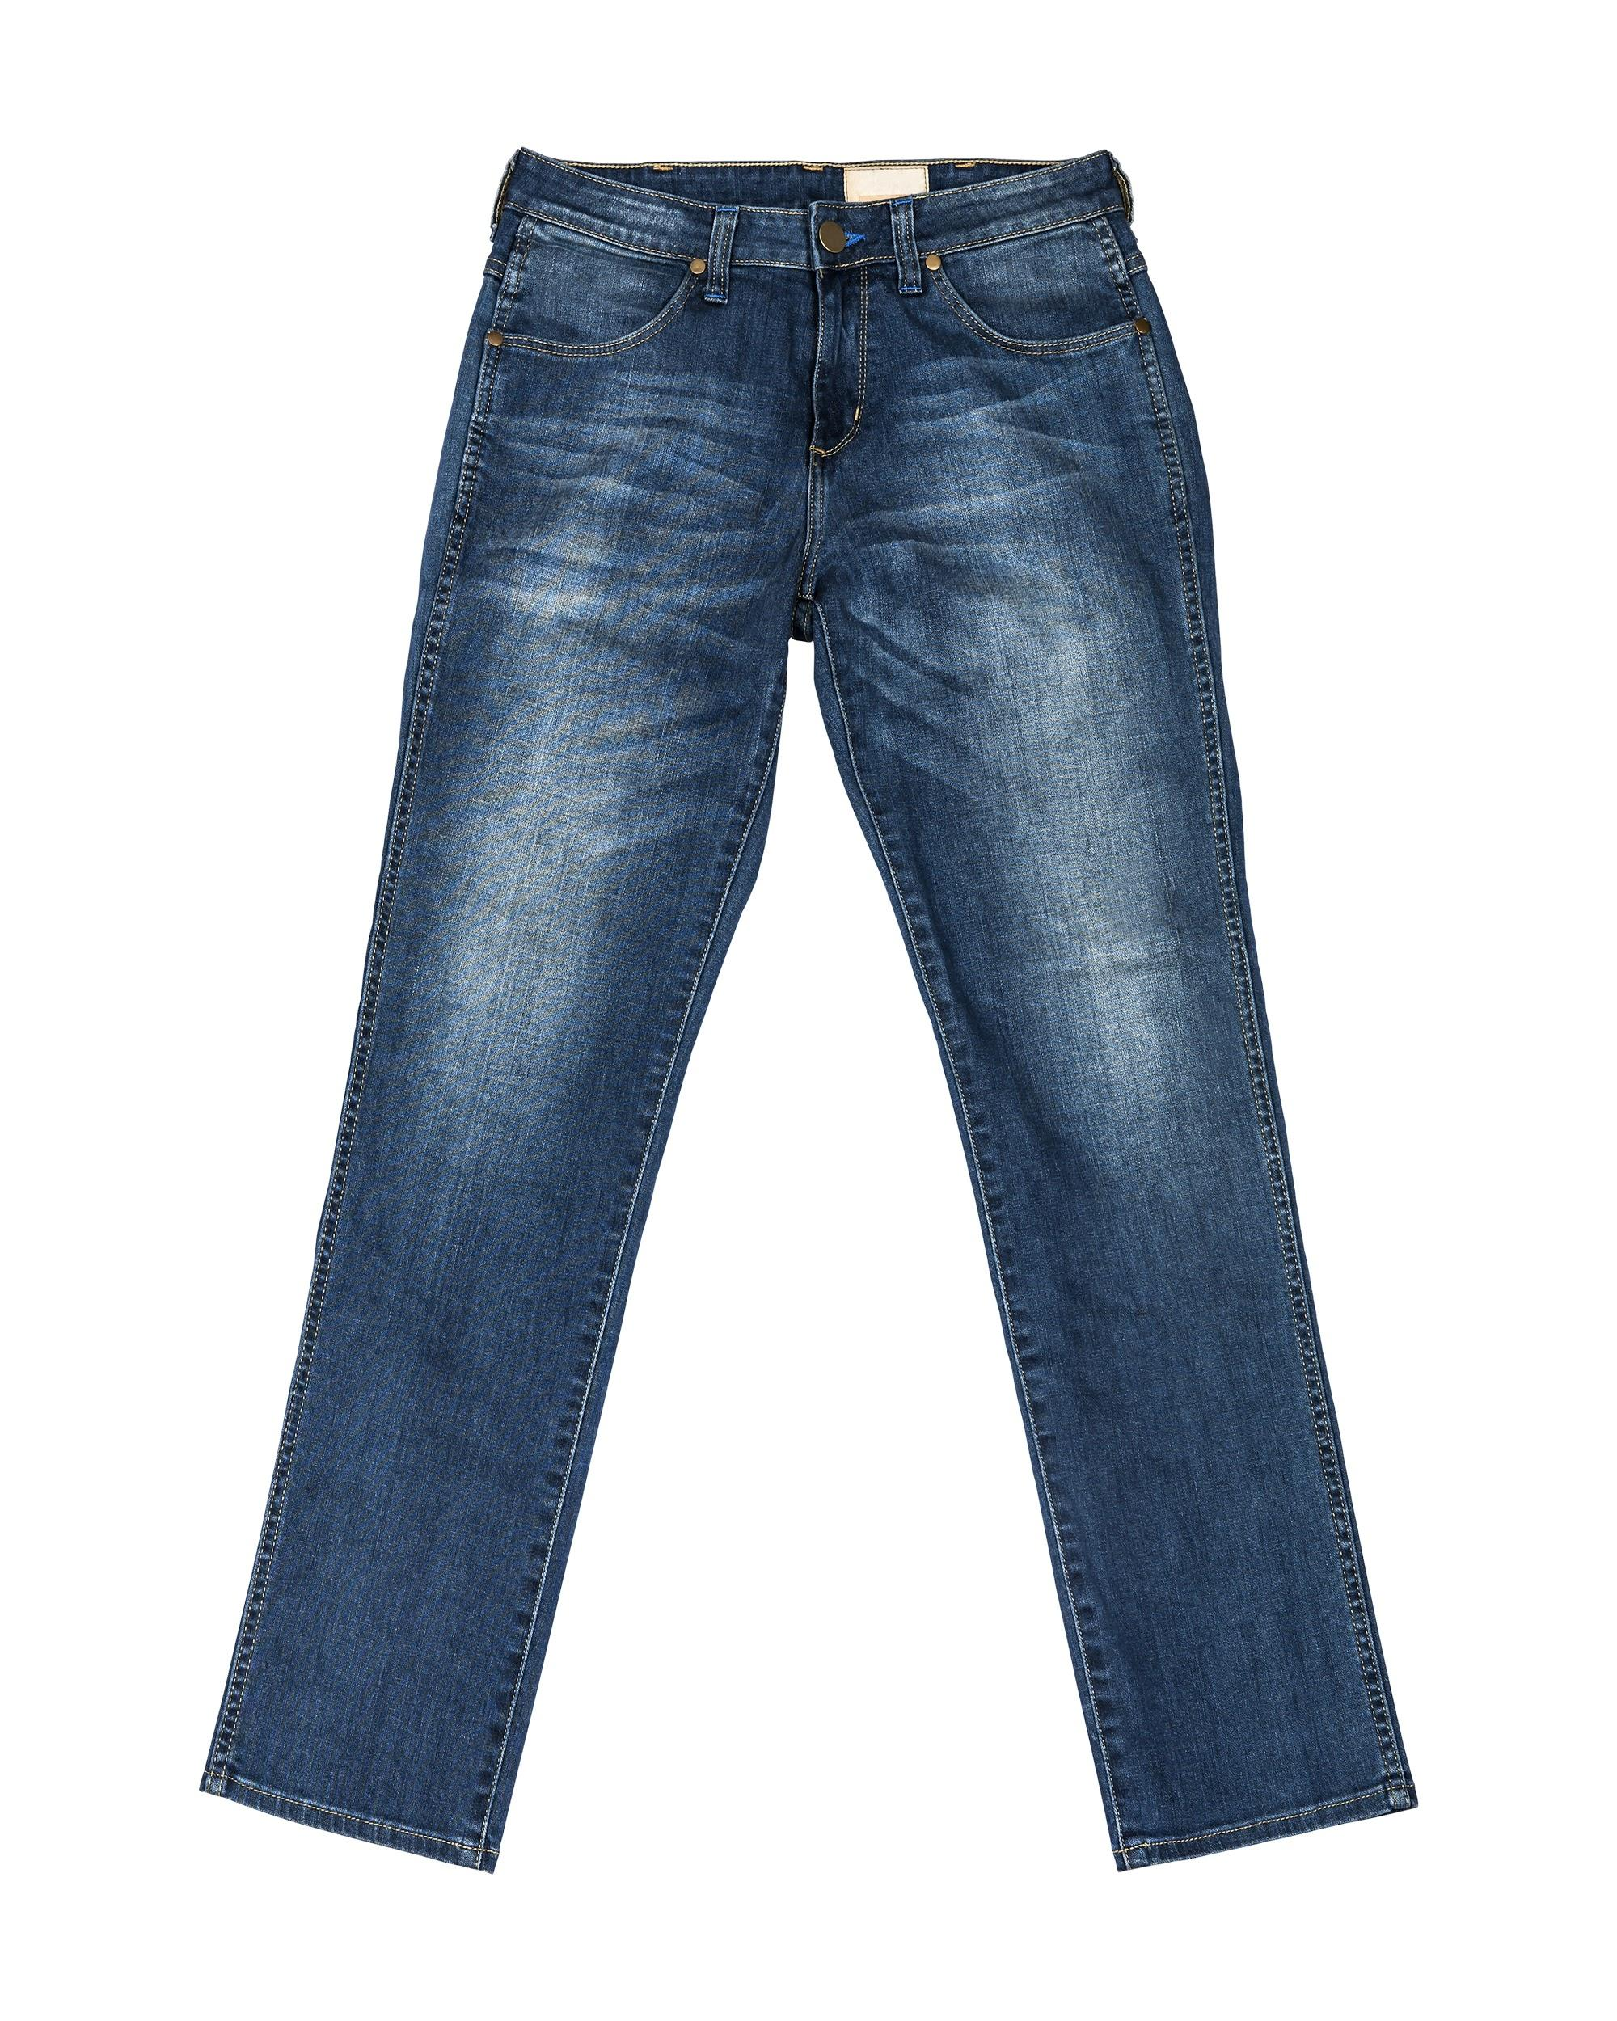
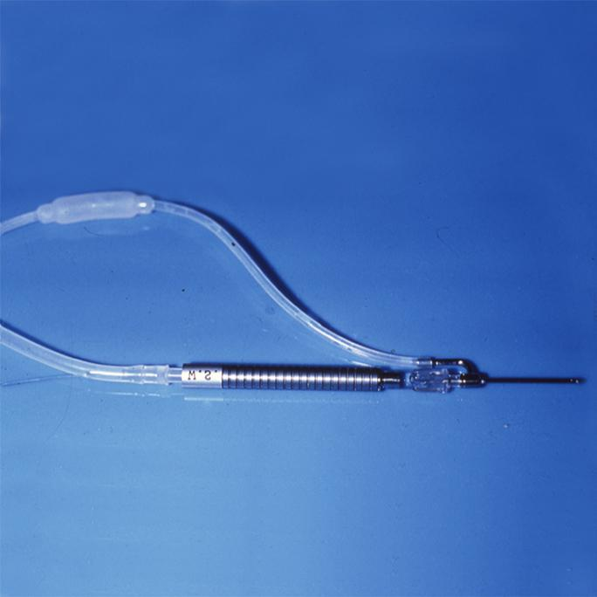
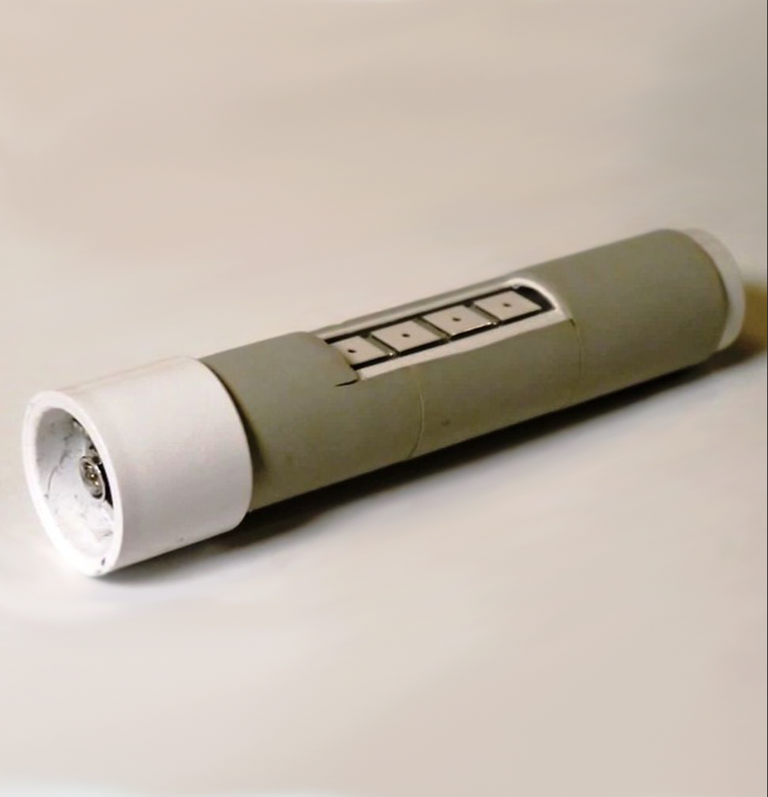

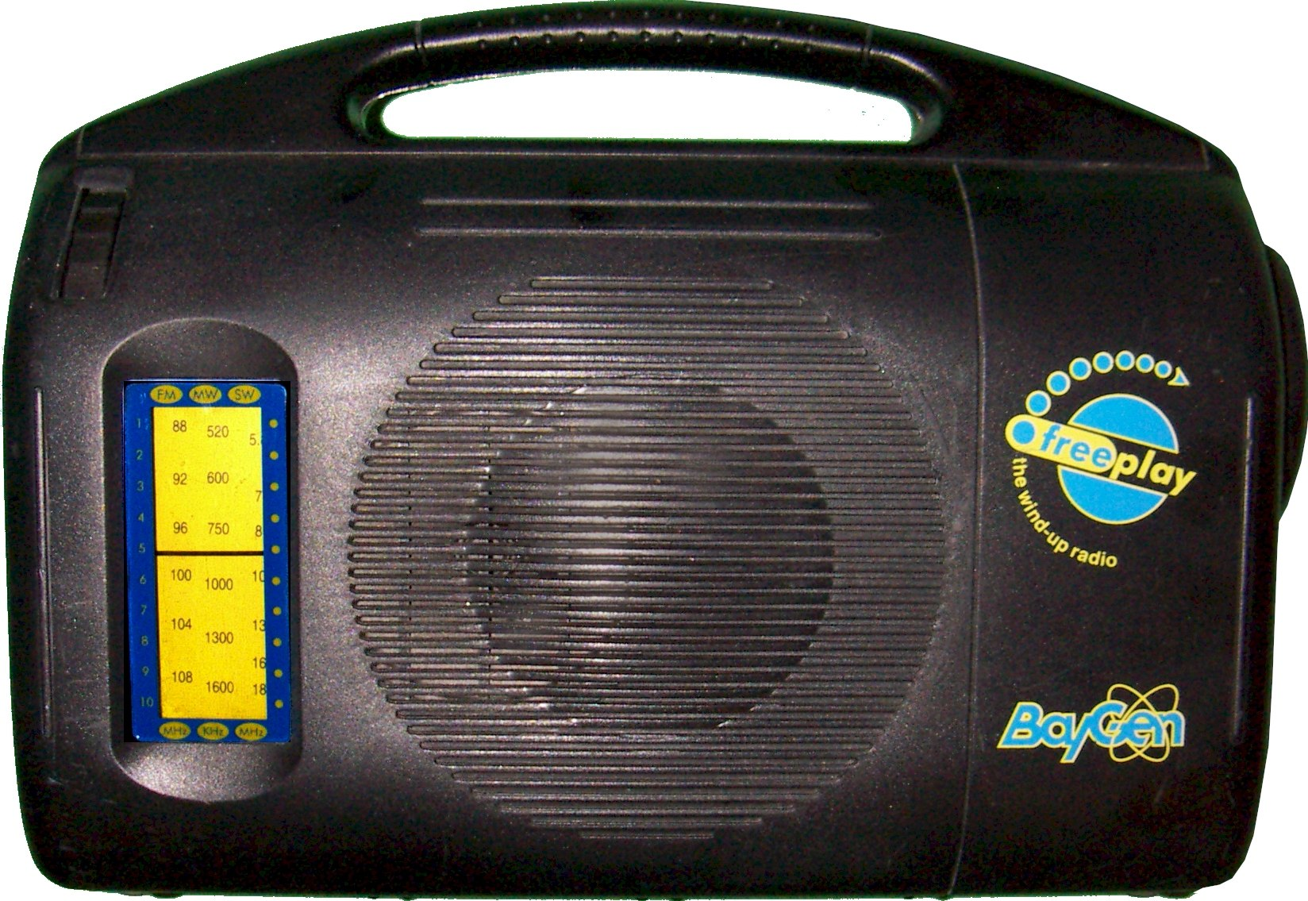
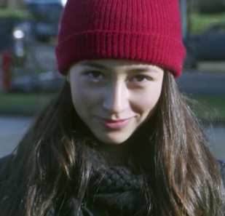
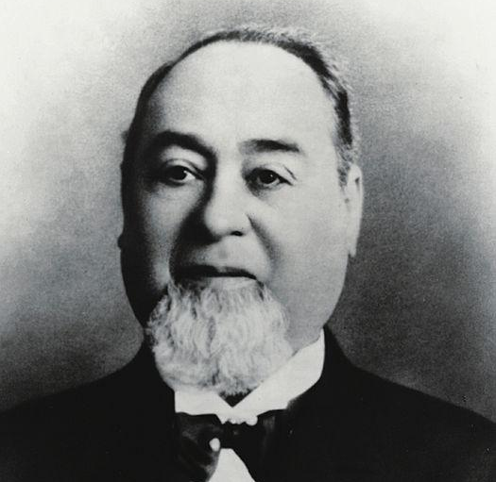
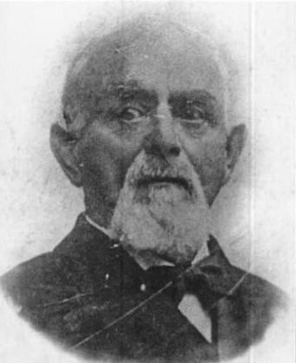
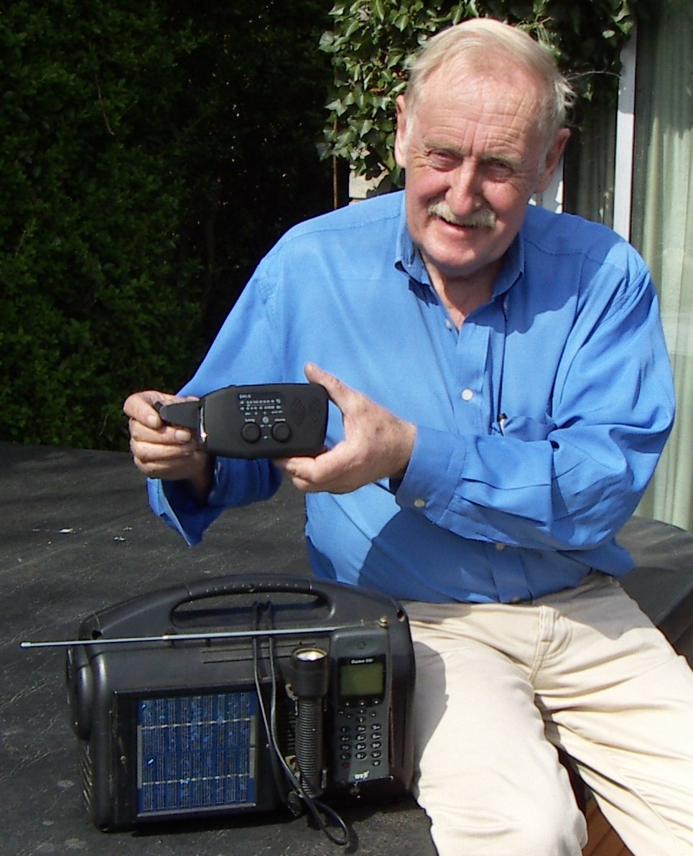
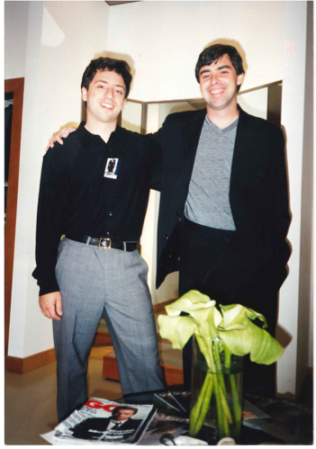
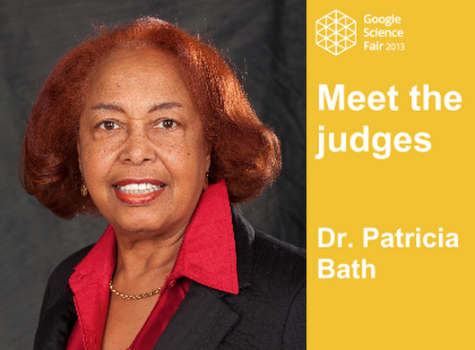
Solutions
Inventors
Notes:
Teacher notes
Show students the images of the solutions.
Can they highlight the key element to the solution that solves the original problem?
Ask students to match the invention to the inventor.

Slide 9
Solutions
Inventors
Hollow flashlight
Riveted jeans
Wind-up radio
Google Inc.
Laserphaco probe
Ann Makosinski
Levis Strauss & Jacob Davis
Trevor Baylis
Larry Page & Sergey Brin
Dr. Patricia Bath
Notes:
Teacher notes
Run through the answers and emphasize the impact these inventions have had, and that these people aren’t all ‘scientists’ - they are people who had a question that they tried to answer.
Ann Makosinski: Invented the hollow flashlight to help her friend in the Philippines study after dark, as she didn’t have electricity. Ann experimented with Peltier tiles to create a flashlight that is powered by the heat of a human hand.
Trevor Baylis: Invented the wind-up radio to communicate information about AIDS to people in Africa. A lack of access to batteries or a power source was the problem; a few rotations to the crank was the solution. Anyone could tune in to vital information without the need for batteries or electricity.
Levi Strauss and Jacob Davis: After a customer asked Jacob, a tailor, to find a way to strengthen her husband's work pants, he thought of adding metal rivets at points of strain, such as the corner of pockets and the base of the fly. He went into business with Levi Strauss, who had previously sold him material and, shortly after, the first blue jeans were created.
Patricia Bath: After co-founding the American Institute for the Prevention of Blindness, Dr. Bath worked with laser technology to help treat cataracts with more precision and less pain. In 1981, she created the Laserphaceo Probe and since then has helped thousands of people regain their vision - even people who had been blind for over 30 years.
Larry Page and Sergey Brin: Invented Google in order to organize information on the internet to help users easily find the information they were looking for.

Slide 10
What do all these have in common?
Hollow flashlight
Riveted jeans
Wind-up radio
Google Inc.
Laserphaco probe
Notes:
Teacher notes
Explain that all these inventions solve a specific problem, and they were created by people who were curious.
Reinforce the idea that anyone can be an inventor - they just need to look around them and think ‘how could that be better?’ or ‘what if…?’.
Ann was not a straight A-student or a regular at science fairs. She was just interested and, when her friend had a problem, she wanted to solve it. (They’ll find out more about Ann soon.)
Discuss the idea that inventions are often discussed in terms of impact - how much they have changed a person or many people’s lives.
The first step in coming up with a creative idea is finding a suitable problem, and that’s what we’ll be doing in today's session. It’s essential that, like these inventors, students are passionate about the problem.

Slide 11

What’s going on around you?
Think about your everyday life...
Could your journey to school be more efficient?
Is there a way to recycle more in your community?
Is there something that would make a difference to a friend or family member?
Notes:
Teacher notes
To identify something that they are passionate about, students will need to look close to home.
Run through these questions as an introduction to the next activity. You could add an example based on the school, or perhaps see if anyone has any immediate thoughts.
If you have time, you could discuss the questions above in more detail.

Slide 12
Activity 1: Idea generation diamond
What are you passionate about?
More interested
Climate change
Rearrange the diamond so that the areas that concern you most are nearest the top.
Food science
Space
Healthcare
Coding
Sustainable energy
Robotics/ electronics
Plant or animal conservation
Mental health & social science
Less interested
Notes:
Teacher notes
Give student a copy each of Activity 1: Idea generation diamond and ask them to follow the instructions:
Cut out each of the diamonds and read what is on them
Put the thing they are least interested in at the bottom
Complete the diamond, working their way up, putting the things they find most interesting towards the top
What they’re most interested in should be at the very top. What are their favorite things about the top three?
Encourage students to discuss and justify their choices.
In twos or threes, ask students to compare and discuss their diamond.
Explain to students they should now be in a position to make a more refined search in looking for the problem they want to solve.

Slide 13

Activity 2: Research summary
Dig deeper into your top three areas
What’s going on locally, nationally, globally?
What changes could make a positive impact?
What inventions already exist in this field?
What recent developments have there been?
What key challenges are there?
Notes:
Teacher notes
Ask students to begin to research the top three areas of their diamond.
Give out Activity 2: Research summary for students to complete. They can use the prompts above to kickstart their research.
Encourage students to think beyond what they see on screen - for example, they could speak to people to gain a stronger understanding of issues.

Slide 14
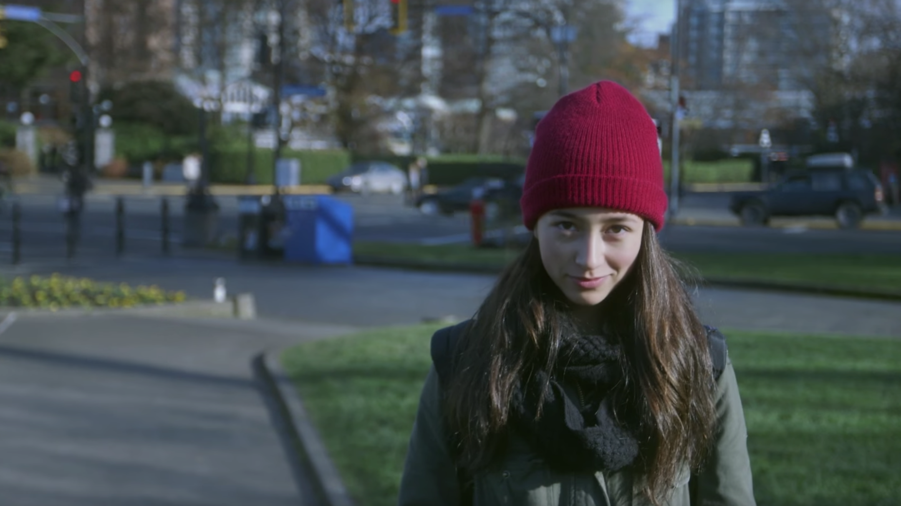
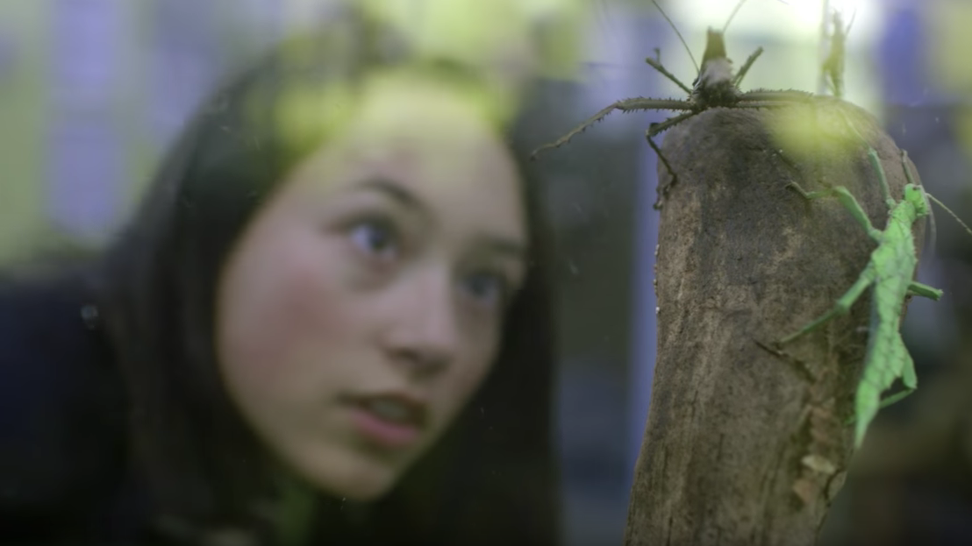
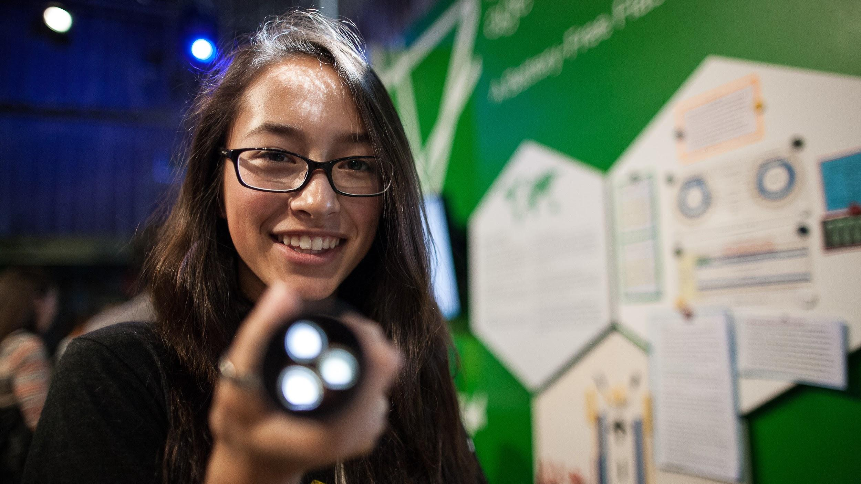
Case study
Ann Makosinski
Age 16
Play film
How can we provide light for children to study when they have no access to electricity?
Notes:
Teacher notes
Interrupt students halfway through their research with a two-minute clip of a case study.
Ann Makosinski is a previous winner of Google Science Fair. Students were introduced to her and her hollow flashlight at the beginning of the session.
Highlight that Ann found her question to answer through a friend.
Encourage students to think close to home and within their own communities about challenges faced, not just the big problems that are in the global news pages.
Allow students to continue researching.

Slide 15
How feasible is it for you to find a solution?
Impact
Solvability
Notes:
Teacher notes
Ask students to pair up and discuss their research with their partner. Students can help each other to assign their problem to an appropriate area on the graph.
You can prompt them with some questions:
Who will benefit from solving this problem?
Which age group(s)?
How many people will it impact?
How will it impact them?
Students haven’t solved the problem yet, but ask them to think about its potential - how solvable do they think it is? Near impossible, or worth looking into?
Ask each pair to join with another pair to have a look at each other’s ideas within a group of four.
Finally, ask each student to pair up with someone new, and repeat the process.
Encourage students to look out for others with similar ideas.
Ask the class as a whole if any of their ideas were similar. Identify any students who would benefit from teaming up (teams of up to 3 can enter Google Science Fair).
Explain that they need to focus on one specific problem for the next phase. The problem nearest the dot is the one to go for!

Slide 16

Turn your problem into a key question
How can we…? Is there an alternative to…? How much does…? Could we create…? What if…? Is it possible…?
Notes:
Teacher notes
Using their problem nearest the dot, ask students to create a clear key question outlining what they will investigate.
E.g. Ann’s problem was that her friend had no electricity but needed to study at night to succeed in school. Her question was ‘How can we provide light for children to study when they have no access to electricity?’
Students can use the sentence starters above to help formulate their question.

Slide 17
Now that you have your problem, it’s time to start solving it!
Session 2: Generate ideas

